Slide 1
Final Project Presentation
By Aamir Ghouse

Slide 2
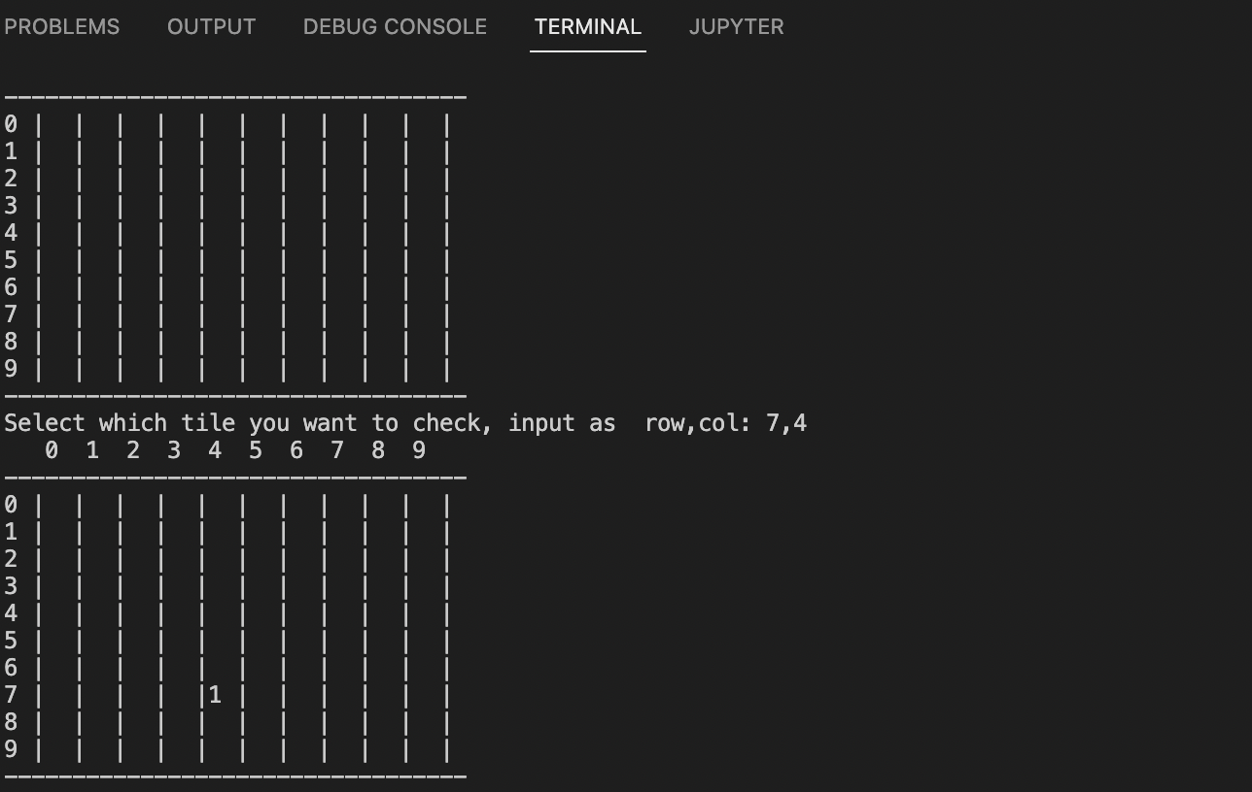
For my final project I wanted to recreate minesweeper in Python. Minesweeper is a puzzle game where you are given a grid of numbers, and have to pick which tiles do not have mines on them.

Slide 3
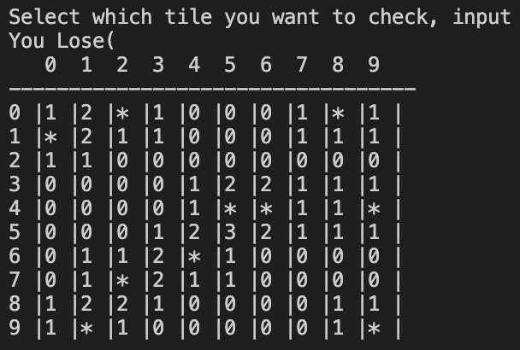
To make this program I had to learn how to generate images in python, and commands we did not use in class like the classify command.

